Slide 1
DRAFT
All figures are placeholders, illustrative only
RadX inc.
Illustrative Acquisition Proposal
Prepared for [Practice Name]
August 2026
20+ centers in six states
Florida
Georgia
Tennessee
Alabama
Michigan
Maryland
Confidential: not for further distribution
Presentation Does Not Constitute a Binding Offer - Figures Subject to Confirmatory Due Diligence

Slide 2
Disclaimer
RadX
This presentation (the "Presentation") has been prepared by RadX, Inc. ("RadX") solely for the benefit of [Practice Name] (the "Company") for discussion purposes. The information contained herein is confidential, is being provided to the Company on a strictly limited basis and may not be reproduced or disseminated in whole or in part without the prior written consent of RadX.
This Presentation does not constitute and should not be relied upon as an offer to buy any securities. Any such offer, if made, will be made only pursuant to definitive legal documentation, subject to the terms and conditions contained therein, and in compliance with all applicable laws and regulations.
The information contained herein is preliminary in nature and is subject to change, completion and verification. All financial figures and valuations included in this Presentation are provided for illustrative purposes only, are based on certain assumptions that may change, and remain subject to confirmatory due diligence and further negotiation. RadX makes no representation or warranty, express or implied, as to the accuracy or completeness of the information contained herein and shall have no liability relating to or resulting from the use of this Presentation or any errors or omissions herein.
Nothing contained herein constitutes legal, tax, accounting or investment advice. Recipients of this Presentation should make their own independent evaluation of the information and consult with their own professional advisors as they deem appropriate.
By accepting this Presentation, the Company acknowledges and agrees to be bound by the foregoing limitations.
RadX inc. · Confidential
Presentation Does Not Constitute a Binding Offer - Figures Subject to Confirmatory Due Diligence
2

Slide 3
Why RadX?
RadX
A radiologist-led platform built to be the right home for an independent practice
01
A Radiologist Leading Radiologists
02
Your Practice Stays Your Practice
RadX was founded and is led by Dr. Chintan Desai, MD, a practicing radiologist rather than a financial sponsor
Clinical decisions are made by people who have read the studies, managed the schedule and built the referral relationships themselves
We preserve local clinical staff, physician relationships and referral networks
Integration focuses the back office (billing, scheduling, credentialing), not the medicine or the people your referrers know
03
A Proven Operating Playbook
04
Optionality on How You Exit
RadX has grown from 7 to 20+ centers across six states through a repeatable five-step integration framework
RadX has delivered meaningful EBITDA growth across acquired centers without cutting clinical quality
Take full value at close, or defer a portion and participate in the growth of a larger platform
The structure flexes to what you want your next chapter to look like: full exit, phased transition or continued practice
RadX inc. · Confidential
Presentation Does Not Constitute a Binding Offer - Figures Subject to Confirmatory Due Diligence
3

Slide 4
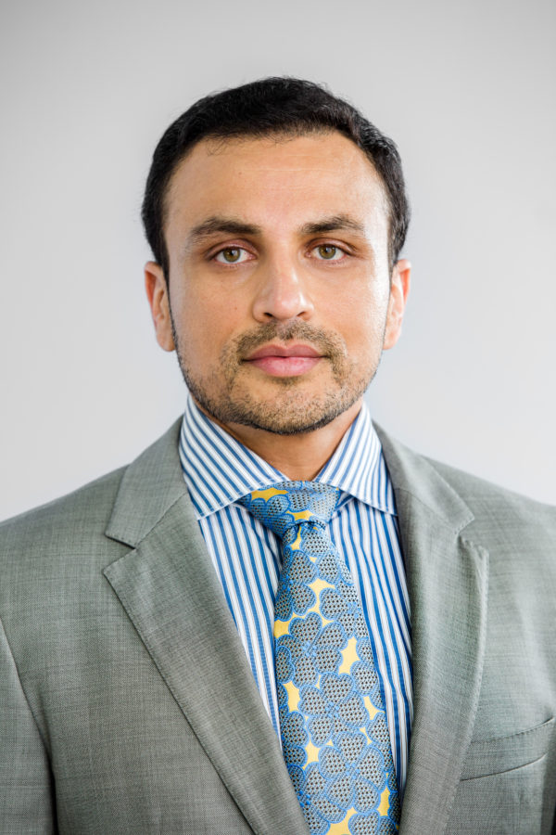
Founded and Led by an Experienced Radiologist
RadX
Dr. Chintan Desai has built RadX as a practicing radiologist, not an outside investor
Clinical Leadership
President, Florida Radiological Society
Chief Medical Officer, Rose Radiology Center
Fellowship, Duke University · M.D., University of Miami
Operating & Business Background
MBA, Harvard Business School
Hands-on across clinical operations, revenue cycle management, scheduling and multi-state platform management
Founded RadX in 2023 and scaled it from 7 to 20+ centers
Dr. Chintan Desai, MD
Founder & Chief Executive Officer
Alignment With Sellers
Personally led the acquisition and integration
of every center on the platform to date
Dr. Desai has rolled 100% of his own proceeds into the platform alongside institutional capital
He is invested in the same security as every other equity holder, including sellers who elect to roll
RadX inc. · Confidential
Presentation Does Not Constitute a Binding Offer - Figures Subject to Confirmatory Due Diligence
4

Slide 5
Overview of Proposed Transaction
RadX
There are three potential components of your go-forward proceeds under our proposal
Total Potential Consideration to the Seller:
$43M+
1. Cash at Close
2. Deferred Consideration
3. Rollover Equity in RadX
$30M
$8M
$5M
Paid in full at closing
Funded from committed capital, with no financing contingency
Subject to customary working capital adjustment and escrow
Portion of purchase price deferred and paid post-close
Structured as seller note and/or holdback
Provides certainty of value while bridging to the platform story
Elect to roll a portion of proceeds into platform equity
Same security and same priority as the founder and institutional investors
Participates in the growth and eventual scale of the full platform
Opportunity for additional upside from rollover equity appreciation
Note: All figures illustrative and subject to confirmatory diligence. Mix between cash, deferred consideration and rollover equity is flexible and can be tailored to seller preference.
RadX inc. · Confidential
Presentation Does Not Constitute a Binding Offer - Figures Subject to Confirmatory Due Diligence
5

Slide 6
Illustration of INITIAL Consideration
RadX
Below represents a graphical illustration of initial consideration of $43 million at close. Does not include any appreciation of equity value
$5M
$43M
$38M
Deferred Cash
$8M
Paid to the Company in the form of the Rollover Equity at Close
Cash at Close
$30M
Total Cash
Seller Rollover Equity
Initial Consideration
Note: Illustrative only. Holdback / escrow released post-closing subject to customary indemnity and net working capital true-up. Rollover equity issued in the same security as capital invested by the founder and institutional investors.
RadX inc. · Confidential
Presentation Does Not Constitute a Binding Offer - Figures Subject to Confirmatory Due Diligence
6

Slide 7
TBD: Content to be updated and edited
Overview of the RadX Operating Playbook
RadX
What RadX does after close to grow revenue at an acquired center
Modality Mix
Shift volume toward higher-value studies on the equipment already in place
Payer Rates
Consolidate every center onto platform contracted rates
Referral Engine
A formal sales organization that owns referral growth in each market
Patient Access
Centralized scheduling that converts demand into booked studies
Better mix and stronger rates lift revenue per scan
Stronger referrals and easier access add more scans
Study mix shifts toward higher-value modalities on the equipment already in place
Payer terms move onto platform contracted rates, narrowing the gap to RadX blended collections in your market
A largely fixed cost base means most of the incremental revenue per scan converts to EBITDA
Referral development across both physician and personal-injury channels in your local market
Centralized scheduling and call handling convert more inbound demand into scheduled appointments
Longer operating hours and shorter backlogs add capacity without new capital
RadX inc. · Confidential
Presentation Does Not Constitute a Binding Offer - Figures Subject to Confirmatory Due Diligence
7

Slide 8
Illustrative Example of EBITDA Growth Under RadX
RadX
Fuller schedules and a centralized back office can materially increase a center's EBITDA
Do More With What You Already Have
Illustrative Single-Center EBITDA
Most centers have room to run more volume on the equipment already in place. Better scheduling and steadier referral flow fill that gap without the need for additional capital
Illustrative center, a few years into the RadX model
Shift the Mix and Reset the Rates
Growth Opportunity With RadX’s Playbook
Higher-value studies, led by MRI, take a larger share of the schedule. Contracted payer rates move onto platform terms, so the same study collects more than it does today
Centralize the Back Office
Billing, credentialing, procurement and image reads move onto the RadX platform, which takes cost out of the center. Your clinical team and local relationships stay in place
Same physicians, same equipment but a materially different earnings profile
At Close
Year 2
Note: Illustrative economics for a single center. The $1.0M to $2.0M path assumes all three drivers shown at left are executed by Year 2. Actual results vary by center.
RadX inc. · Confidential
Presentation Does Not Constitute a Binding Offer - Figures Subject to Confirmatory Due Diligence
8

Slide 9
Rolled Equity in the RadX Platform
Presentation Does Not Constitute a Binding Offer - Figures Subject to Confirmatory Due Diligence
RadX inc.

Slide 10
Overview of Rolled Equity in the RadX Platform
RadX
Rolled equity is valued at platform multiples, not single-practice multiples
A SINGLE PRACTICE and a scaled platform are valued very differently. Rollover equity in the RadX platform enables the seller to benefit from the difference in valuation
EV / EBITDA multiple
Rollover Equity Appreciation Opportunity
Benefits of Participation in RadX’s Growth
Meaningful cash at close, whatever you elect to roll
Same security and priority as founder and institutional capital
Upside from EBITDA growth and from the platform multiple at exit
Single Company
Valuation
Scaled Platform
Valuation
Note: Multiple ranges are illustrative and based on observed public and private comparables for scaled outpatient imaging platforms. No particular exit valuation is assured.
RadX inc. · Confidential
Presentation Does Not Constitute a Binding Offer - Figures Subject to Confirmatory Due Diligence
10

Slide 11
Illustration of Total Consideration Over Platform’s Lifecycle
RadX
Applying the platform multiple to your rolled equity, total consideration reaches $58M
Rollover Equity is realized only at a RadX liquidity event or upon sale of the RadX platform. Rollover equity realization will occur alongside other RadX common equity
Consideration At Close: $43M
$15M
$58M
$5M
$38M
Appreciation in Seller’s equity stake in RadX at Exit (represents 4x return)
Deferred Cash
$8M
Paid to the Company in the form of the Rollover Equity at Close
Cash at Close
$30M
$5M Equity Rollover Grows To $20M At Exit
Total
Cash
Seller Rollover
Equity
Seller’s Equity
Appreciation
Total
Consideration
Note: Illustrative only. Total consideration of $58M assumes rolled equity grows to four times its value at close upon a platform liquidation event. Holdback / escrow released post-closing subject to customary indemnity and net working capital true-up.
RadX inc. · Confidential
Presentation Does Not Constitute a Binding Offer - Figures Subject to Confirmatory Due Diligence
11

Slide 12
Retained Equity in Center
Presentation Does Not Constitute a Binding Offer - Figures Subject to Confirmatory Due Diligence
RadX inc.

Slide 13
Assumptions Behind the Illustrative Example
RadX
A simple illustration of how the transaction and your retained interest work
RadX acquires 80% of your center. You retain 20%. The four assumptions below drive every figure on the page that follows.
RadX acquires 80% of your center at a 6.0x EBITDA multiple
1
$1.0M EBITDA × 6.0x × 80% = $4.8M of cash to you at close
2
You retain 20% of the equity in your business
3
You keep 20% of the annual cash flow every year until a sale
4
Note: Purchase multiple, ownership split and cash flow share are shown for illustration and are subject to confirmatory diligence and definitive documentation.
RadX inc. · Confidential
Presentation Does Not Constitute a Binding Offer - Figures Subject to Confirmatory Due Diligence
13

Slide 14
Illustrative Value of Your Retained Equity in Your Center
RadX
Retained ownership shares in the cash flow the operating playbook creates
The same business, generating more cash. The RadX playbook lifts EBITDA at your center. Your ownership percentage stays the same, so the same slice is worth more.
AT CLOSE
AFTER RADX IMPROVEMENTS (YEAR 2)
RadX acquires 80% of the equity in your center for $4.8M of cash at close and the Seller retains 20% of the equity value
The RadX operating playbook grows the business, lifting center EBITDA to $2.0M within two years
Benefits of Retaining Equity
$2.0M of EBITDA
Meaningful cash at close
You keep 20% of your own center
Distributions rise as cash flow grows
Your 20% is worth more as EBITDA grows
$1.0M of EBITDA
20%
Retained
Ownership
20%
Retained
Ownership
$1.2M retained equity value (6.0x EBITDA)
plus $200K per year (20% of EBITDA)
$2.4M retained equity value (6.0x EBITDA)
plus $400K per year (20% of EBITDA)
Note: Illustrative example only. Assumes $1.0M of center EBITDA at close doubling to $2.0M within two years and a 6.0x EBITDA multiple on a retained 20% interest, consistent with the assumptions on the prior page. Annual cash flow continues until a sale of the center.
RadX inc. · Confidential
Presentation Does Not Constitute a Binding Offer - Figures Subject to Confirmatory Due Diligence
14

Slide 15
TEAM TO EDIT
Overview of Path to Close
RadX
RadX is prepared to move from signed LOI to closing in approximately 5 weeks
Indication of Interest
Confirmatory Diligence
Closing
Preliminary terms shared and mutual fit discussion
Quality of earnings, payer and billing review, equipment and lease diligence
Funding of cash consideration and issuance of any rollover equity
Today
Week 3
Week 5
Weeks 1 – 2
Week 4
Signed LOI & Exclusivity
Definitive Documentation
Economics and structure agreed; diligence period begins
Purchase agreement, rollover documentation and employment terms negotiated in parallel
RadX funds acquisitions from committed capital, so there is no financing contingency and no third-party approval required to close
RadX inc. · Confidential
Presentation Does Not Constitute a Binding Offer - Figures Subject to Confirmatory Due Diligence
15

Slide 16
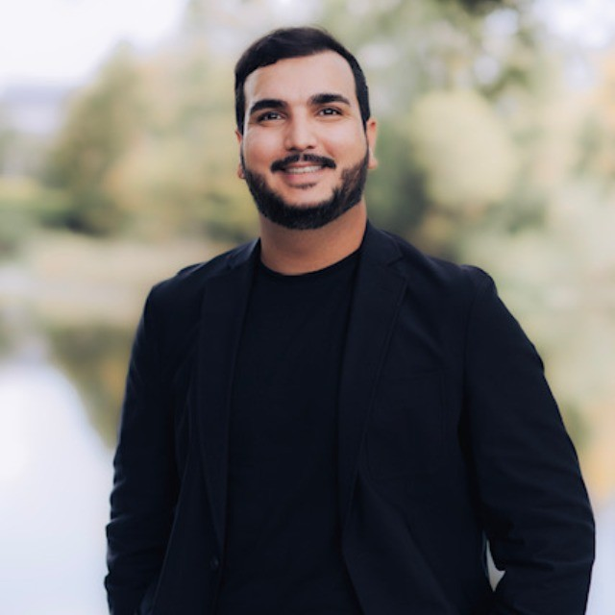
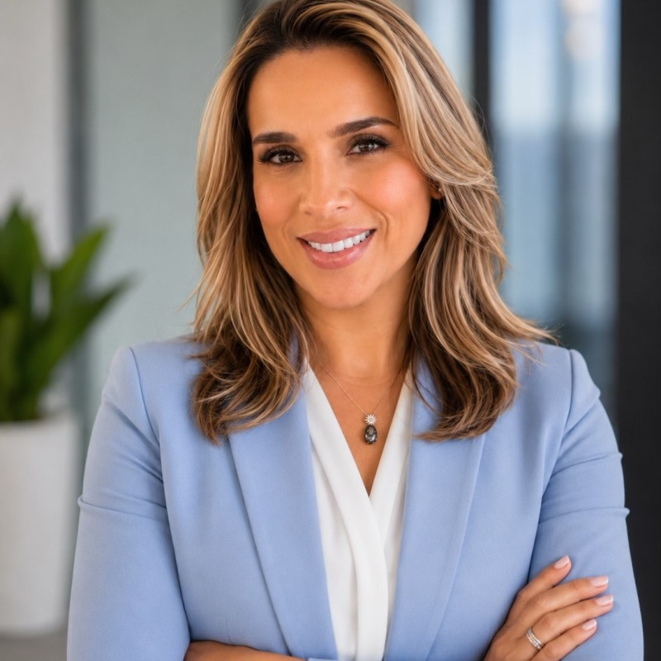
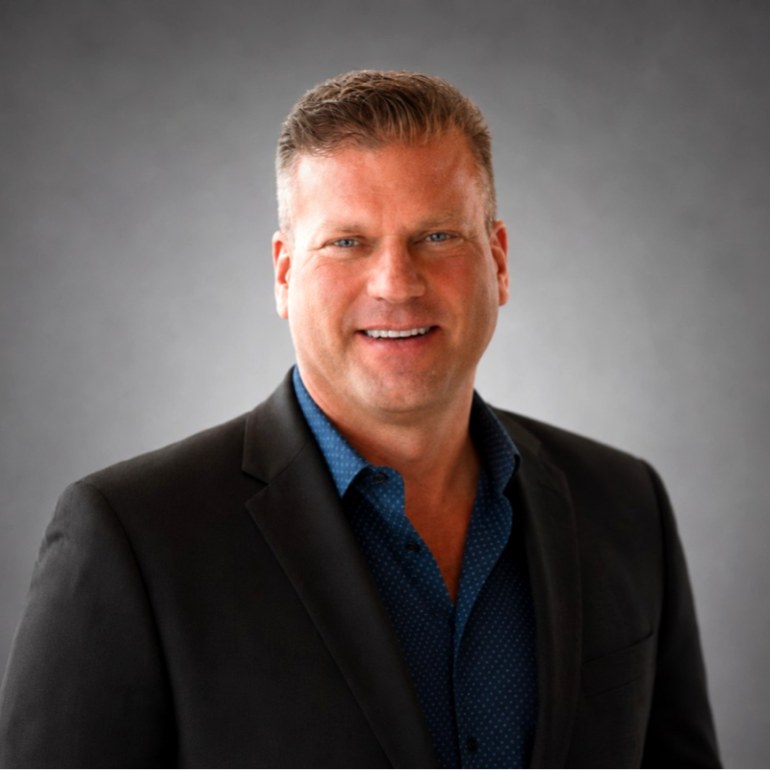
Overview of the RadX Team
RadX
An experienced corporate team supporting every center on the platform
Dr. Chintan Desai, MD
Alejandro Mursuli
Ailenis San Martin
Brent Garnes
Founder & Chief Executive Officer
Chief Financial Officer
VP of Operations
VP of Business Development
President, Florida Radiological Society
CMO, Rose Radiology Center
MBA, Harvard Business School
VP Finance, Innovacare Health
Director of Finance, MMM of Florida
MBA, Nova Southeastern University
VP Market Operations, InnovaCare Health
Practice Admin, Urban Health Physicians
MBA, Keiser University
FL Regional Marketing Director, CareFirst
Regional Marketing Director, Gateway
Clayton State University
The corporate team absorbs billing, credentialing, scheduling infrastructure and payer management, so the practice can focus on clinical delivery and referral relationships
RadX inc. · Confidential
Presentation Does Not Constitute a Binding Offer - Figures Subject to Confirmatory Due Diligence
16

Slide 17
RadX inc.
Next Steps
1
Review the accompanying Letter of Intent (“LOI”)
2
Connect with the RadX team to discuss any outstanding LOI points
3
Execute the LOI and begin confirmatory diligence
4
Introduce you to the operating team and, if helpful, to physicians who have already sold to RadX
Dr. Chintan Desai, MD · Founder & Chief Executive Officer · RadX, Inc.
drdesai@radxinc.com · (XXX) XXX-XXXX · 20+ centers across Florida, Georgia, Tennessee, Alabama, Michigan and Maryland
Presentation Does Not Constitute a Binding Offer - Figures Subject to Confirmatory Due Diligence

